Slide 1
OER: a Collaborative Catalyst for Open Practice?
OER14
University of Newcastle
28th April 2014

Slide 2
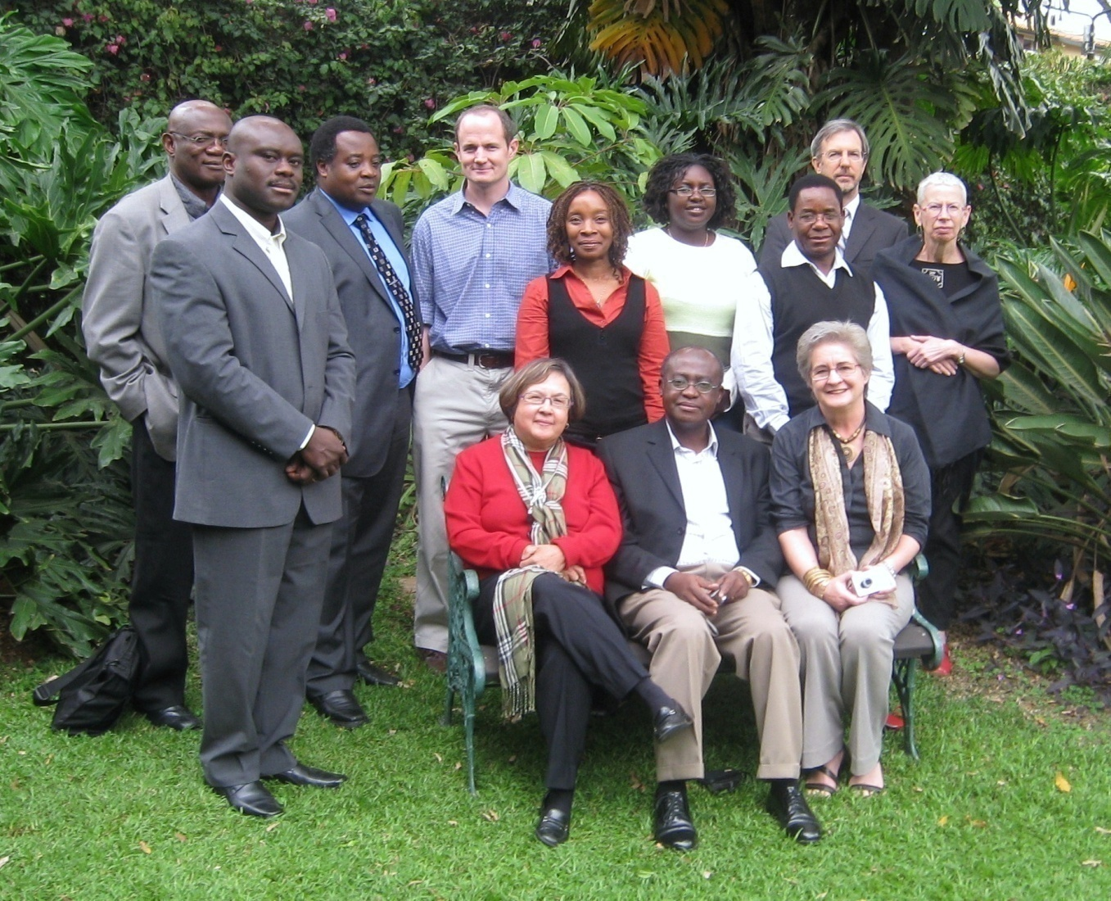
OER Africa is:
An innovative initiative of Saide
Headquartered in Nairobi, Kenya
Established to play a leading role in driving the development and use of OER in Africa.
Funded by the William & Flora Hewlett Foundation, the Bill & Melinda Gates Foundation, and a variety of projects and partnerships across Africa.

Slide 3
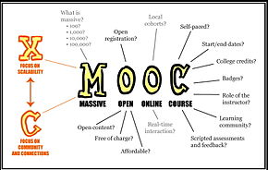
Notes:
Open Education sign… http://ctlt.ubc.ca/programs/communities-of-practice/open-education/
Come in.. http://learningcatalyst.org/welcome/?p=79
MOOC… http://en.wikipedia.org/wiki/Massive_open_online_course
Guidelines… http://commons.wikimedia.org/wiki/File:Guidelines_for_Open_Educational_Resources_%28OER%29_in_Higher_Education.pdf
The Open Classroom… http://beyondthescores.wordpress.com/2012/10/14/the-open-classroom/
Creative Commons… http://www.scribemedia.org/2009/01/23/commons-commons-whats-non-commercial-anyway/

Slide 4
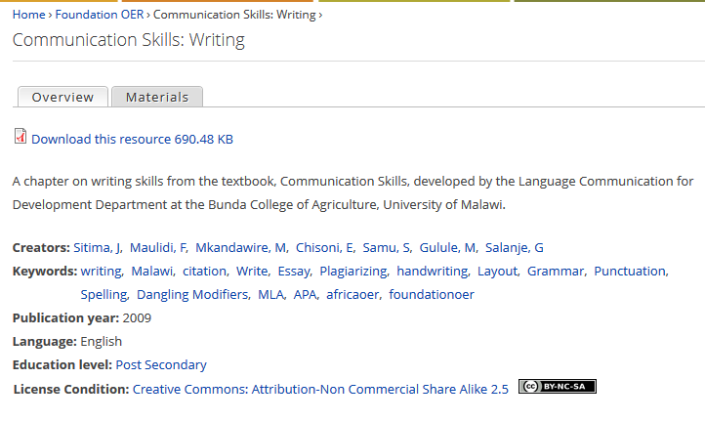

Slide 5
Kamuzu College of Nursing
http://www.oerafrica.org/ResourceResults/tabid/1562/mctl/Details/id/37994/Default.aspx
Notes:
Importance of this slide is that it also shows how a resource should be indexed if it is to be easily found – and then adapted and used
CD used to supplement lectures and a resource to which students can refer when away from campus

Slide 6
Why ‘do’ OER?
Notes:
https://www.google.co.uk/search?hl=en&site=imghp&tbm=isch&source=hp&biw=1366&bih=576&q=sharing&oq=sharing&gs_l=img.3..0l10.1298.2128.0.2424.7.7.0.0.0.0.203.682.0j4j1.5.0....0...1ac.1.42.img..3.4.476.pGsHNIVnEEQ#facrc=_&imgdii=_&imgrc=fx0uIv19isEngM%253A%3BdeyFvO_i6Hf2xM%3Bhttp%253A%252F%252Frack.0.mshcdn.com%252Fmedia%252FZgkyMDEyLzEyLzA0LzVkLzNuZXdhcHBzZm9yLmFQSi5qcGcKcAl0aHVtYgk5NTB4NTM0IwplCWpwZw%252F6ef3adff%252F00d%252F3-new-apps-for-sharing-gifts-trips-products-8f6cb11bc7.jpg%3Bhttp%253A%252F%252Fmashable.com%252F2011%252F10%252F01%252Fapps-sharing-gifts-trips-products%252F%3B950%3B534

Slide 7
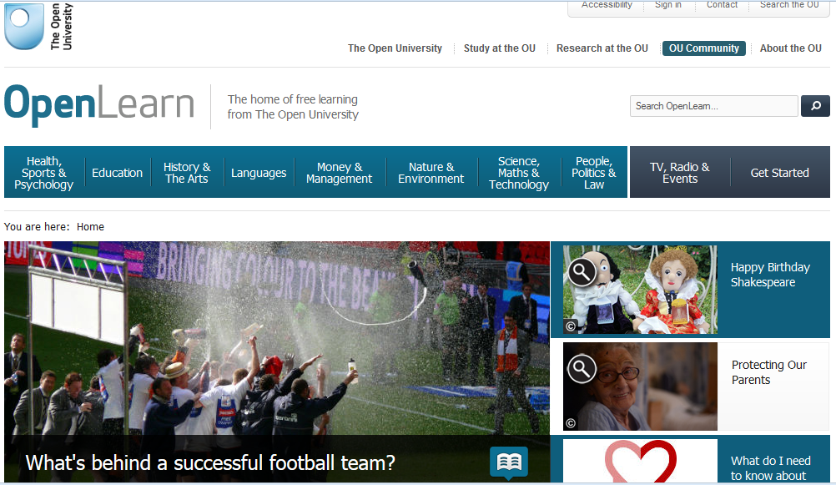
Branding Institutional Knowledge

Slide 8
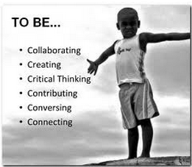
1. READ Course Materials
5. PRODUCE / PERFORM APPROPRIATELY
4. PRACTICE new skills
3. ENGAGE in learning conversations
2. EXPLORE within the discipline
Notes:
Adapted from Laurillard, D. Rethinking University Teaching: A Framework for the Effective Use of Learning Technologies. Routledge Falmer 2001.
Photograph: see here: http://www.educatorstechnology.com

Slide 9
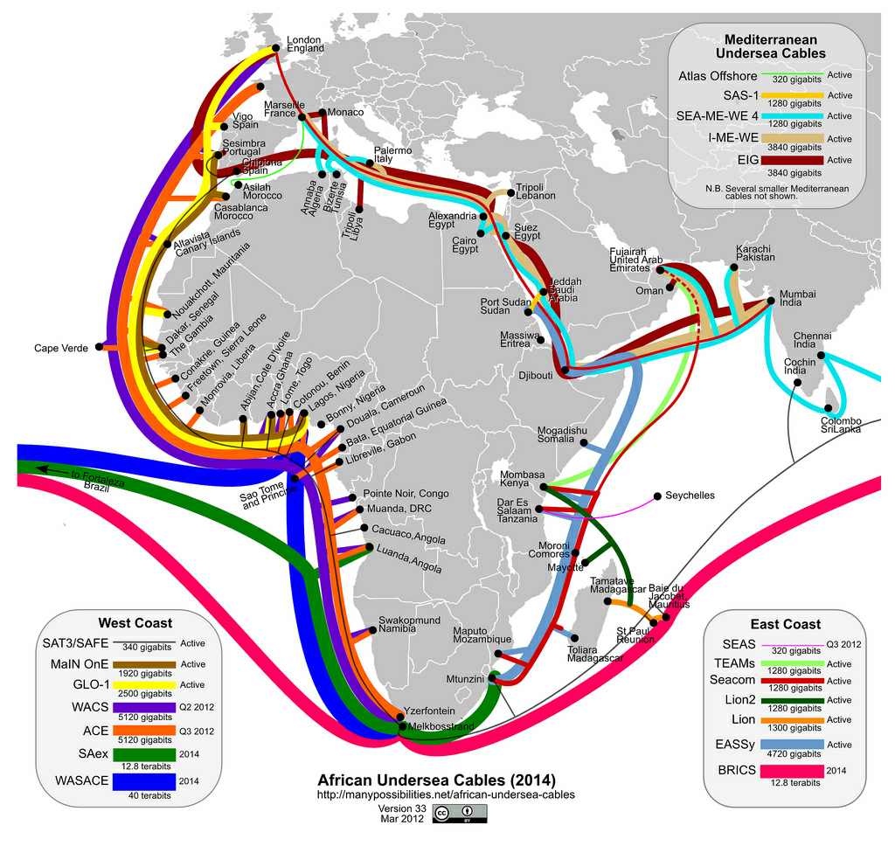
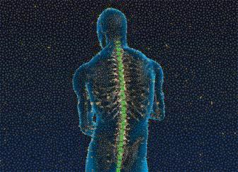
Notes:
http://jellyfishcoolman.files.wordpress.com/2009/07/african-submarine-fibre-optic-cables.jpg
Spinal Image: http://www.murrelektronik.com

Slide 10
What does it all mean?
Notes:
For spatial analysis image, see here: http://www.spatialanalysis.ca/2011/global-connectivity-mapping-out-flight-routes/

Slide 11
Notes:
(see http://www.oerafrica.org/FTPFolder/health/bloodcounts/course_intro/index.htm)

Slide 12
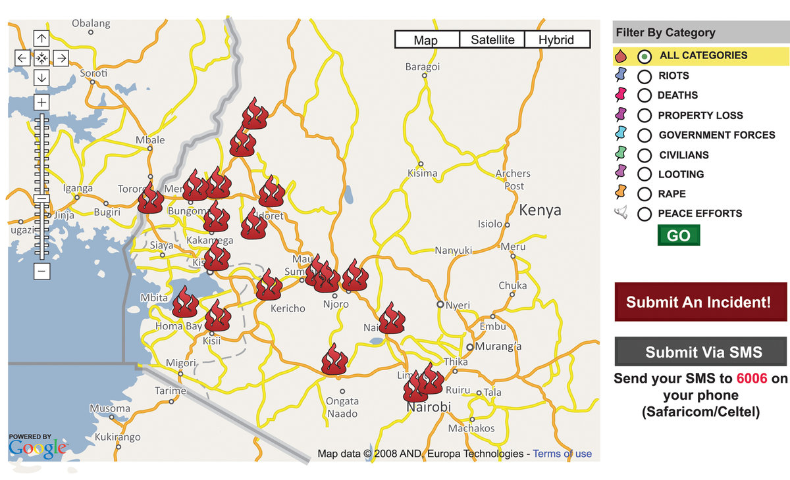

Slide 13
http://ushahidi.com/products/brck/

Slide 14
Does OER = Open Practice?
Free Open Source Software
Open Data
Open Access Research
Open Educational Resources
???

Slide 15
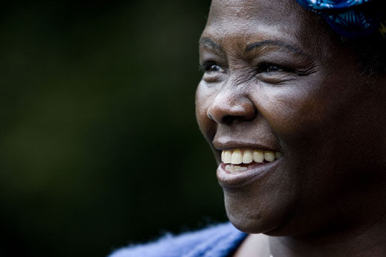
Prof. Wangari Maathai (1940-2011) Nobel Laureate, 2004
“I’m very conscious of the fact that you can’t do it alone. It’s teamwork. When you do it alone you run the risk that when you are no longer there nobody else will do it.”
Notes:
“I’m very conscious of the fact that you can’t do it alone. It’s teamwork. When you do it alone you run the risk that when you are no longer there nobody else will do it.”

Slide 16
Thank you
This work is licensed under a Creative Commons Attribution 4.0 License
Catherine Ngugi
OER Africa Project Director
catherine.ngugi@oerafrica.org
Neil Butcher
OER Strategist
neilshel@nba.co.za

Slide 17
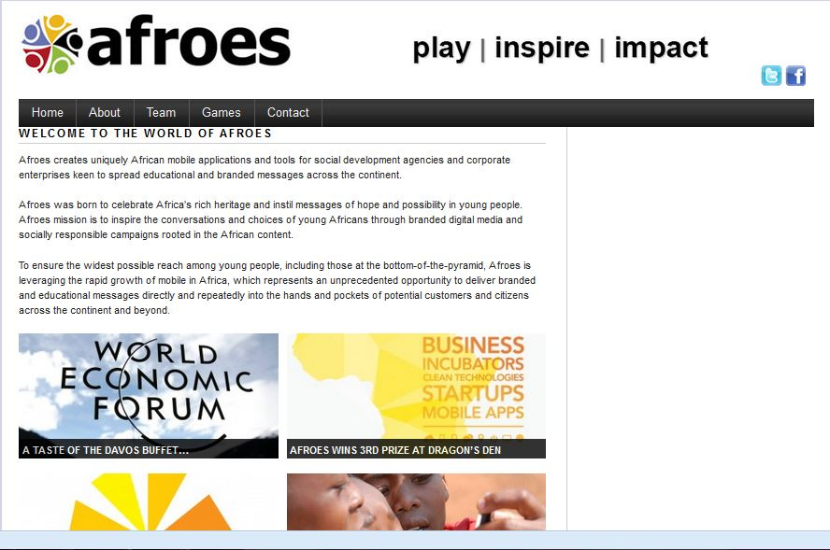
Afroes & Ushahidi
http://www.afroes.com/

